Slide 1
LOW LIGHT IMAGE ENHANCEMENT
19BCE1499 Vishwanath B Bhat
19BCE1668 Likith M D
19BCE1476 C R Dhruv

Slide 2
ABSTRACT
In this Project, we are going to implement an efficient fusion-based process for enhancement of the weakly illuminated images which takes use of several image processing techniques. Firstly, we would deploy an illumination estimating algorithm based on the morphological closing methodology for decomposing an input image into a reflectance image and an illumination image. Next, we get two inputs which represent the luminance-improved and contrast-enhanced images of the previous illuminated images using the sigmoid function and adaptive histogram equalization. Then we produce an adjusted illumination by combining the developed inputs with their corresponding weights in a multi-scale way. By using a proper weighting and fusion plan, we will merge the benefits of different techniques to develop the adjusted illumination. Finally, the enhanced image shall be obtained by compensating the already adjusted illumination back to the reflectance. By this fusion-based technique, images of weak illumination conditions like night time images and backlight images can be enhanced

Slide 3
LITERATURE SURVEY
Photographic Tone Reproduction for Digital Images
The paper first describes an existing classic photography challenge that is, the conversion of real-world high luminance range images to the range of low dynamic range of the photographic print. The same tone reproduction issue is faced by professionals working in the field of animation and computer graphics and they must deal with the mapping of digital images to a screen or to a print of low dynamic range. Within this paper, the research reported uses tried-and-true photography approaches such as dodging and burning and luminance mapping to create a novel tone reproduction operator. Ansel Adams' approach for dealing with digital photographs is utilized in this regard. The final resultant method is elementary and has been proved to deliver decent outputs over a diverse range of photos.

Slide 4
METHODOLOGY
Based on the research paper we decided to implement the proposed architecture in that paper. There were other alternatives but this particular model is extremely simple as well as powerful. The suggested fusion-based method works by combining numerous inputs and weights obtained from a single estimated illumination. Global brightness improvement, local contrast enhancement, and preservation of detail are the three criteria for enhancing weakly light images, as stated above. As a result, these criteria are used to create and process inputs and weights. The proposed boosting method is made up of four basic steps that correspond to the four subsections below:

Slide 5
• Illumination estimation
• Input derivation,
• Weight definition
• Multi-scale for input and weight fusion.

Slide 6
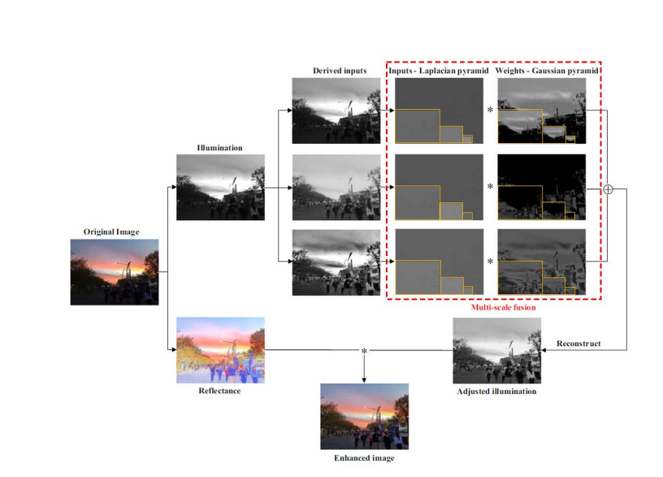

Slide 7
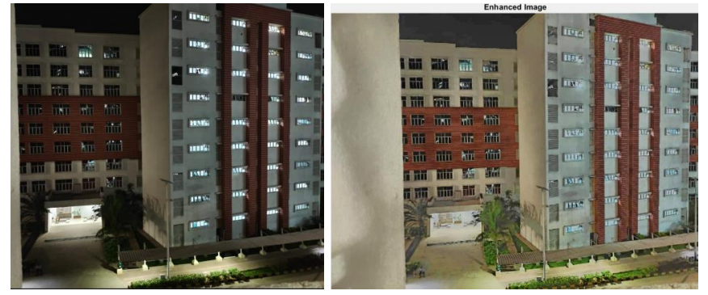
OUTPUTS

Slide 8
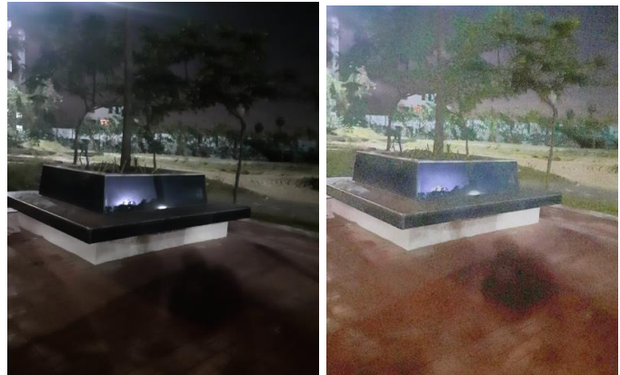

Slide 9
Conclusion and Future work:
The model is able to enhance low light image excellently considering it is computational inexpensiveness compared other neural network models The model seems to be struggling for images having extreme noise. Additional noise removal algorithms can also be added to model to improve the overall model.

Slide 10
References:
[1] C. Lee, C. Lee, C.S. Kim, Contrast enhancement based on layered difference
representation of 2d histograms, IEEE Trans. Image Process. 22 (12) (2013)
5372–5384.
[2] Z. Zhou, S. Li, B. Wang, Multi-scale weighted gradient-based fusion for multifocus images, Inf. Fusion 20 (2014) 60–72.
[3] T. Mertens, J. Kautz, F.V. Reeth, Exposure fusion, in: Proceedings of 15th Pacific
Conference on Computer Graphics and Applications, 2007, pp. 382–390.
[4] Z.G. Li, J.H. Zheng, S. Rahardja, Detail-enhanced exposure fusion, IEEE Trans.
Image Process. 21 (11) (2012) 4672–4676.

Slide 11
[5] R.C. Gonzalez, R.E. Woods, Digital Image Processing, Prentice-Hall, Englewood
Cliffs, NJ, USA, 2007.
[6] E.D. Pisano, S. Zong, B.M. Hemminger, Contrast limited adaptive histogram
image processing to improve the detection of simulated spiculations in dense
mammograms, J. Digit. Imaging 11 (4) (1998) 193–200.
[7] Y.T. Kim, Contrast enhancement using brightness preserving bi-histogram
equalization, IEEE Trans. Consum. Electron. 43 (1) (1997) 1–8.
[8] D. Coltuc, P. Bolon, J.M. Chassery, Exact histogram specification, IEEE Trans.
Image Process. 15 (5) (2006) 1143–1152.
[9] T. Arici, S. Dikbas, Y. Altunbasak, A histogram modification framework and its
application for image contrast enhancement, IEEE Trans. Image Process. 18 (9)
(2009) 1921–1935.
[10] T. Celik, T. Tjahjadi, Contextual and variational contrast enhancement, IEEE
Trans. Image Process. 20 (12) (2011) 3431–3441.

